Slide 1
CAPSTONE PROJECT
CARDIOVASCULAR RISK PREDICTION
Presented By:
MIRUDHULA A, 2021305514
Alagappa College Of Technology, Anna University
Department Of Biotechnology- Industrial Biotechnology

Slide 2
OUTLINE
Problem Statement
Proposed System/ Solution
System Development Approach
Algorithm and deployment
Result
Conclusion
Future Scope
References

Slide 3
PROBLEM STATEMENT
Develop a comprehensive predictive model to determine whether the patient has a 10-year risk of future coronary heart disease (CHD), potential risk factor, demographic, behavioral, medical risk factors, general checkup, exercise, Skin cancer, diabetes and arthritis based on historical data.

Slide 4
PROPOSED SOLUTION
Utilizing advanced AI algorithms, our solution will analyse extensive cardiovascular risk prediction data to establish patterns and correlation.
For optimal timing, a predictive model will consider factors such as future coronary heart disease, demographic, behavioural, and medical risk factors.
The ideal prediction will determine through AI analysis, considering the variables like Medical risk and coronary heart disease.
Additionally, a specified model will predict the likelihood of cardiovascular affected risk by examining the number of patients, and their medical risk factors, enabling the prediction measures to the target population or a hospitalised patients for enhanced treatment.
This holistic approach aims to empower the prediction of cardiovascular disease with actionable intelligence for decision making in the dynamic treatment landscape.

Slide 5
SYSTEM APPROACH
Building the proposed solution will involve the combination of AI, data processing, feature engineering, machine learning. Here are the key system and library requirements.
SYSYTEM REQUIREMENTS:
1.Hardware:
-A computer with efficient processing power, preferable with multiple cores or a GPU for faster training of machine learning models.
-Adequate RAM to handle the size of the dataset and computational requirements.
2. Software:
-An operating system compatible with the required machine learning libraries (e.g., Windows, Linux, mOS)

Slide 6
SYSTEM APPROACH – CONT.
Library Requirements:
1.Data Processing and Analysis:
-Pandas: For data manipulation and analysis.
-NumPy: For numerical operation on data.
2. Data Visualisation:
-Matplotlib and seaborn: For creating visualisation to understand data patterns.
-Plotly or Bokeh:Interactive visualisation libraries for more complex visualisation.

Slide 7
ALGORITHM AND DEPLOYMENT
Algorithm selection
Data Exploration:
Explore the cardiovascular risk dataset’s structure, features, target variables.
Identify potential patterns, correlation and outliers.
Problem Formulation:
Define the problem: Predict optimal cardiovascular heart disease.
Algorithm Selection:
Regression tasks (e.g., predicting daily rates):
Consider linear regression, decision tree, or ensemble methods (XGBoost, LightGBM).
Classification tasks(e.g., predicting special requests):
Consider logistics regression, decision trees, or random forests.

Slide 8
ALGORITHM AND DEPLOYMENT
Data Input:
Gather historical Cardiovascular risk prediction, including information on diabetes, arthritis, exercise, skin cancer and regular checkup.
Data Cleaning:
Handle missing values, outliers, and any inconsistencies in the dataset.
Convert categories variables into numerical representations through encoding techniques.
Feature Engineering:
Create new features or modify existing ones based on domain knowledge.
Extract meaningful information from data variables, such as day-of- week or month.

Slide 9
ALGORITHM AND DEPLOYMENT
Training Process:
Data Splitting:
Divide the dataset into training and testing sets to evaluate the model’s performance.
Feature Scaling:
Standardize or normalize numerical features to ensure they have a consistent scale.
Model Training:
Use the selected algorithm to train the model on the training dataset.
Adjust hyperparameters to optimize model performance.
Model Evaluation:
Evaluate the model on the testing dataset using appropriate metrics (e.g., Mean Squared Error for regression, accuracy, precision, recall for classification.
Fine-tune the model if necessary.

Slide 10
ALGORITHM AND DEPLOYMENT
Prediction process
New Data Input:
Collect new data or use existing data to make predictions.
Preprocessing:
Apply the same data preprocessing steps to the new data.
Model Inference:
Use the trained model to make predictions on the new data.
Results Interpretation:
Interpret the model’s predictions in the context of the problem at hand.
For regression, interpret the predicted values as optimal rates of prediction of cardiovascular disease prediction. For classification interpret predictions as the likelihood of special requests.

Slide 11
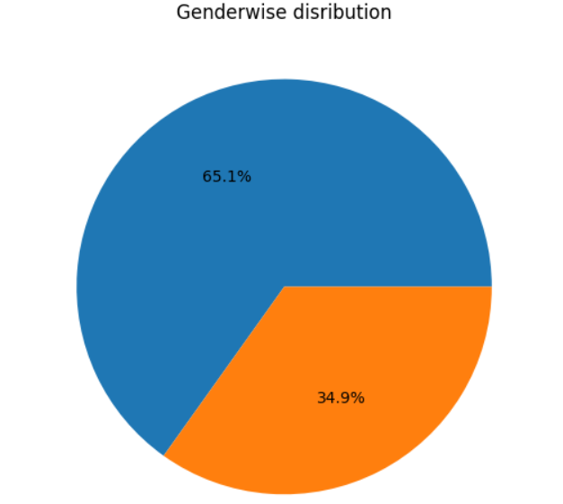
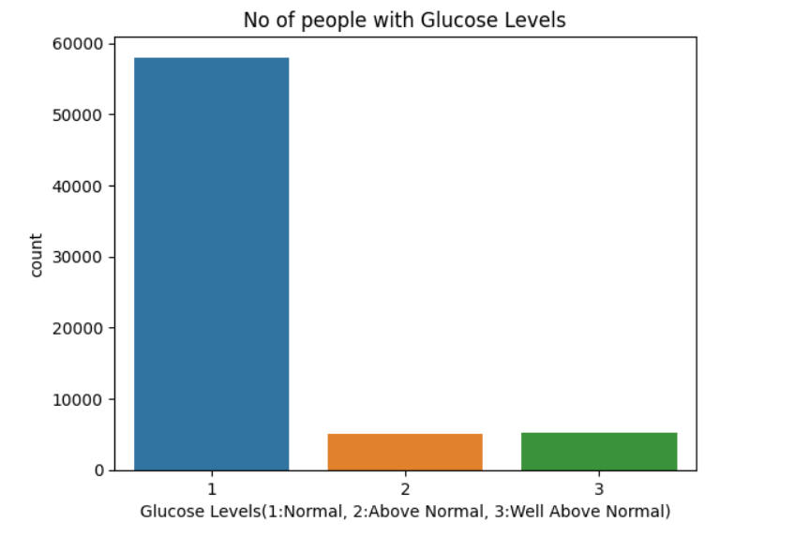
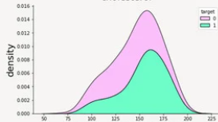
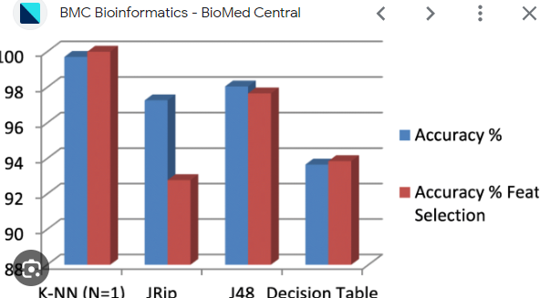
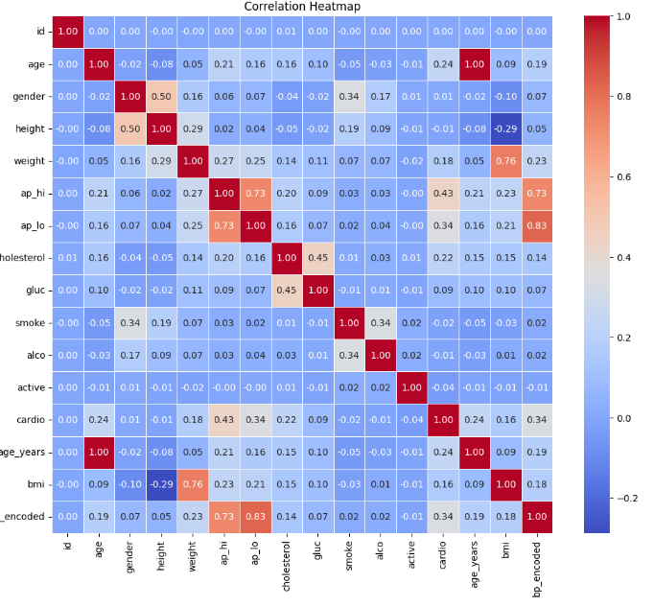
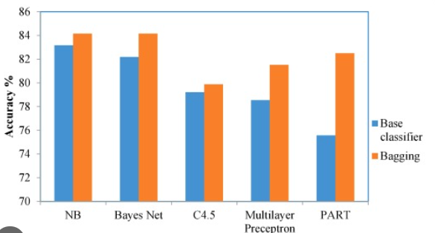
RESULT

Slide 12
CONCLUSION
In conclusion, our proposed solution harnesses the power of advanced AI and machine learning algorithms to predict the Cardiovascular disease and various associated factors. By meticulously analysing extensive historical booking data, we unlock patterns and correlations that are pivotal in addressing key challenges faced by diabetic and cardiovascular disease patients.

Slide 13
FUTURE SCOPE
The proposed solution lays the foundation for ongoing advancements in the realm of cardiovascular disease prediction. Here are the key areas for future exploration and enhancement.
Real time Prediction:
Move towards real time predictive models that account for instant changes in demand, external events and other dynamic factors to provide users with up to the minute insights for prediction.
Personalisation and Customization:
Enhance the predictive models to offer more personalised recommendations by considering individual guest preferences, loyalty history, and user specific requirements, providing a tailored experience for each patient.

Slide 14
REFERENCES
https://www.mdpi.com
https://www.ncbi.nlm.nih.gov/pmc/articles/PMC10150633/
https://journalofbigdata.springeropen.com/articles/10.1186/s40537-023-00817-1
https://www.nature.com/articles/s41598-023-40717-1
https://www.hindawi.com/journals/cin/2023/9418666/
https://www.kaggle.com/datasets/sulianova/cardiovascular-disease-dataset

Slide 15
THANK YOU

